Slide 1

OpenStack Image Customisation
Graham J Land/ June 10th, 2015

Slide 2
Image Customisation
Why ?
  Hypervisor Support
  Image Format
What ?
  Storage
  Public SSH keys
  Network
  Custom data
How ?
  OpenStack Vendor Pre-Packaged Images
  Manual Image Creation
    Cloud-Init or scripts
  Automated Image Creation Tools

Slide 3
Why do we need to customise images for OpenStack?
Hypervisor support
  Vmware, KVM, Hyper-V, Xen all will need different drivers added to their OS instances
Format - capability
  RAW : simplistic block device representation of the image
  QCOWs : QEMU Copy on Write
    Improved upload performance
    Optimised storage footprint
    Snapshot functionality built-in
  VMDK : Vmware disk image format
  AMI/AKI/ARI : Amazon image formats
  Etc…many other supported disk formats

Slide 4
What is customised?
Ephemeral Storage
  Based on flavor selection the storage will resize automatically
Network
  Original hardware MAC details must be purged OpenStack will supply the new MAC information upon instance creation
Firewall
  Best practice to disable instance firewall and use firewall provided by Security Groups
SSH server enabled
  SSH public keys and custom metadata are injected into the new instance at initial boot time using SSH

Slide 5
How to get Customised Images
Operating System Vendors
  Vendors have quickly realised this new revenue stream and many offer OpenStack ready images that can be uploaded directly to Glance. Minor modifications may be required.
Custom Image Creation
  Manual : Download the required operating system, build template system, customise, publish to Glance.
    Cloud-Init versus Scripts
  Automated : Use thirdparty OpenStack image builder tools

Slide 6
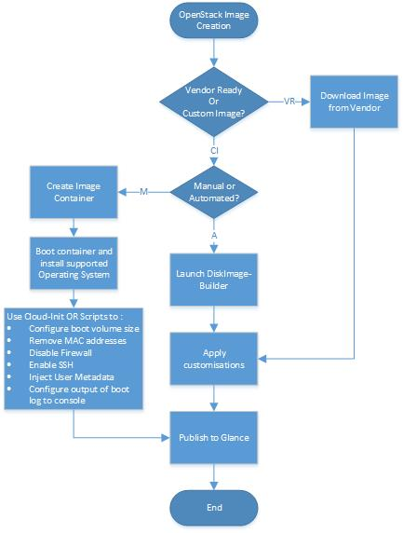
Image Creation Workflow

Slide 7
Ubuntu example (source OpenStack Docs)
Shutdown Instance
# /sbin/shutdown -h now
Clean up (remove MAC address details)
# virt-sysprep -d trusty
Undefine the libvirt domain
# virsh undefine trusty
# qemu-img create -f qcow2 /tmp/trusty.qcow2 10G
# virt-install --virt-type kvm --name trusty --ram 1024 \
--cdrom=/data/isos/trusty-64-mini.iso \
--disk /tmp/trusty.qcow2,format=qcow2 \
--network network=default \
--graphics vnc,listen=0.0.0.0 --noautoconsole \
--os-type=linux --os-variant=ubuntutrusty
Step through the standard installation process and add OpenSSH Server at the software selection stage
Re-attach CDROM following reboot (libvirt bug/feature)
# virsh start trusty --paused
# virsh attach-disk --type cdrom --mode readonly trusty "" hdc
# virsh resume trusty
Log in to the newly created image
# apt-get install cloud-init
# dpkg-reconfigure cloud-init [select EC2 metadata service]
Configure Cloud-Init service account by editing /etc/cloud/cloud.cfg
user: admin

Slide 8
Windows example (source OpenStack Docs)
$ qemu-img create -f qcow2 ws2012.qcow2 15G
# virt-install --connect qemu:///system \
--name ws2012 --ram 2048 --vcpus 2 \
--network network=default,model=virtio \
--disk path=ws2012.qcow2,format=qcow2,device=disk,bus=virtio \
--cdrom /path/to/en_windows_server_2012_x64_dvd.iso \
--disk path=/path/to/virtio-win-0.1-XX.iso,device=cdrom \
--vnc --os-type windows --os-variant win2k8
Use Virt-manager to connect to the console and step through the installation
Enable the VirtIO drivers
The disk is not detected by default by the Windows installer. When requested to choose an installation target, click Load driver and browse the file system to select the E:\WIN8\AMD64 folder. The Windows installer displays a list of drivers to install. Select the VirtIO SCSI and network drivers, and continue the installation.
When the base OS completes log in as Administrator and launch a CMD window to complete the VirtIO drivers installation
C:\pnputil -i -a E:\WIN8\AMD64\*.INF
Download & Install Cloud-Init
C:\powershell
C:\Set-ExecutionPolicy Unrestricted
C:\Invoke-WebRequest -UseBasicParsing http://www.cloudbase.it/downloads/CloudbaseInitSetup_Beta_x64.msi -OutFile cloudbaseinit.msi
C:\.\cloudbaseinit.msi
In the configuration options window, change the following settings:
Username: Administrator
Network adapter to configure: Red Hat VirtIO Ethernet Adapter
Serial port for logging: COM1
When the installation is done, in the Complete the Cloudbase-Init Setup Wizard window, select the Run Sysprep and Shutdown check boxes and click Finish.
Wait for the machine shutdown.
Upload to OpenStack Glance
$ glance image-create --name WS2012 --disk-format qcow2 \
--container-format bare --is-public true \
--file ws2012.qcow2

Slide 9
Thank you

