Slide 1

OpenStack Heat versus
HP Cloud Service Automation
Graham J Land/ June 10th, 2015

Slide 2
Agenda
Heat Overview
Cloud Service Automation Overview
Comparison
Conclusion

Slide 3
OpenStack Heat Overview

Slide 4
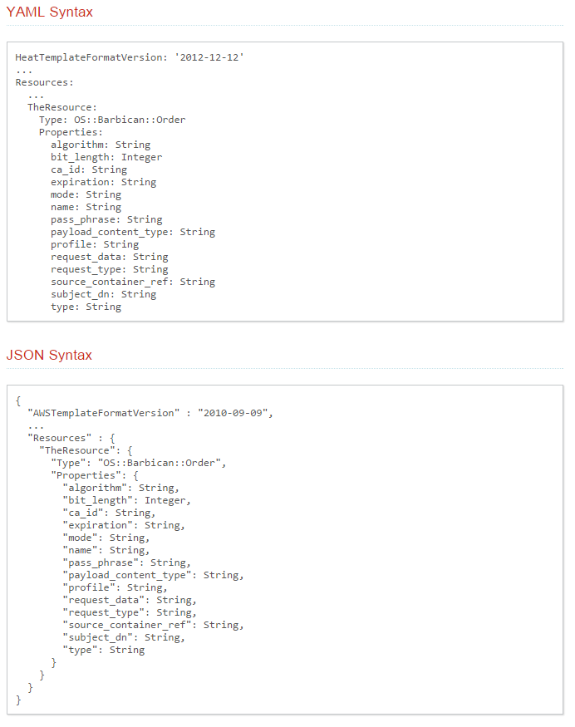
OpenStack Heat Overview
Main Orchestration Project within OpenStack – focused on IaaS
  Heat Stack
  Heat Template
      Parameters
      Resources
      Output
    HOT – Heat Orchestration Template
      YAML
    CFN – AWS CloudFormation Template
      JSON
  Rest API
  Python based
  PaaS achieved through integration with third party automation engines such as chef or puppet

Slide 5
HP Cloud Service Automation Overview

Slide 6
HP Cloud Service Automation
Enterprise grade service lifecycle management for heterogeneous environments
Highly automated service lifecycle management
    Service marketplace with modern user experience
    Highly customizable UI with mash-up capabilities
    Full stack services (SaaS, PaaS, Iaas)
    Sophisticated tools for service design modelling
    Enterprise-grade management
    High availability, security
    Multi-tenant catalogs with role-based access
    Intelligent resource utilization, monitoring and compliance
Flexible, open and extensible architecture
    Multi-hardware, multi-hypervisor
    Public cloud services
    Out-of-box integration with HP and non-HP products
    APIs for third party integration
Service lifecycle
Consume
Create
Cloud
management
Open, extensible architecture
Traditional
Private cloud
Managed cloud
Public cloud

Slide 7




What is Operations Orchestration?
Coordinated execution of automated IT tasks and process workflows
Service Request
Incident
Automated tasks
Change
Scheduled
Event
Ad hoc
Bridging
Coordinated execution
Teams
Tools
Clouds
Process Flows

Slide 8
Comparison

Slide 9

CSA vs Heat

Slide 10
Operations Orchestration vs Heat
Operations Orchestration
  mature
  graphical flow development with capabilities above and beyond simple OpenStack IaaS
  large portfolio of OOB content – reduced time to value
  proven track record for rapid ROI
  orchestrates across the enterprise and beyond – airport runway landing lights
  sophisticated debug & analysis tool
  self documenting flows
Heat
  immature
  focused primarily on OpenStack IaaS
  command line UI for flow development – YAML & JSON text files

Slide 11
Conclusion

Slide 12
Conclusion
If your requirements are purely to orchestrate OpenStack IaaS resources then Heat has been built specifically for this purpose and is evolving quickly.
However, if you wish to move beyond OpenStack Infrastructure to deliver true end-to-end Businesses-as-a-Service with process integration and automation across the enterprise, HP Cloud Service Automation can provide this capability today. Leverage legacy IT, Public Cloud, Private Cloud all from a single, truly heterogeneous, Cloud Service Broker Platform.

Slide 13
Thank You

